Slide 1
The MAX Phases: Unique New Carbide and Nitride Materials

Slide 2
Facts on Energy Consumption
If one could increase the average engine temperature of the world’s jets by one degree Celsius, the fuel savings alone would be worth around $1 billion per year.
A jet engine made from a material 50 percent lighter in weight and able to run 200 to 300 degrees hotter could have a staggering economic impact

Slide 3
ceramics
Ceramics are materials consisting metallic and non metallic substances which are mostly oxides, nitrides and carbides of metals.
Properties : hardness , brittleness , lightweight , high temperature tolerant , resistance to oxidation and thermal shock etc

Slide 4
Ternary ceramics
Ternary ceramics turn out to be surprisingly soft and machinable , yet also heat-tolerant , strong and lightweight.
These ternary ceramics are of the form M_{n+1}AX_{n} or “MAX” phases because of their
composition.
They constitute an exciting new class of materials that is more revolutionary than evolutionary.

Slide 5
OBJECTIVE
Fabricating dense, bulk, ultra refractory materials or MAX phases .
Development of Ti₃SiC₂ ternary ceramic compound by spark plasma sintering .

Slide 6
TITANIUM SILICOCARBIDE (Ti₃SiC₂ )
It is a ternary compound of the form M_{n+1}AX_{n}
which combines properties of both ceramics and metals
Thermally and electrically conducting
Relatively tough and resistant to thermal shock
Low density
Easy machinability
High fatigue crack growth threshold

Slide 7
KEY PROPERTIES
Density (g/cm³) 4.5
Tensile Strength (MPa) 200
Compressive Strength (MPa) 1100
Modulus of Rupture (MPa) 400
Young’s Modulus (GPa) 300
Electrical Conductivity (Ω⁻¹.m⁻¹) 4.5x10⁶
Thermal Conductivity (W/m.K) 37
Co-Efficient of
Thermal Expansion 9x10⁶

Slide 8
Ti₃SiC₂ and oxidation resistance

Slide 9
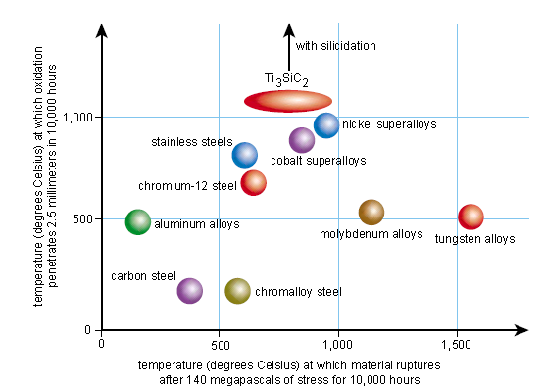

Slide 10
Oxidation resistance and Thermal shock
Titanium silicocarbide exceeds all other materials for oxidation resistance and approaches the nickel super alloys in strength
Thermal shock
750 degree celcius
1200 degree celcius
1400 degree celcius

Slide 11
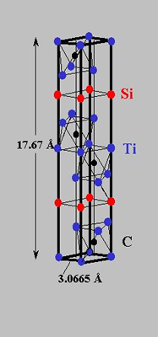
Structure of Ti₃SiC₂
Layered hexagonal structure in which almost close packed planes of Ti are separated by hexagonal nets of Si
Every fourth layer is a Si layer
Carbon atoms occupy the octahedral sites between the Ti layers

Slide 12
Why properties are unusual ?
It has double layers of titanium carbide interleaved with single layers of silicon.
Bonds within the CARBIDE layers are STRONG but bonds BETWEEN THE LAYERS are WEAK
This allows dislocation movement and basal slip – ductile behaviour like metals

Slide 13
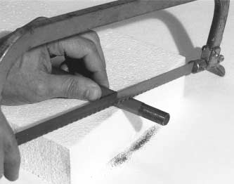
Machinability
Although very stiff and capable of resisting intense thermal shock, the MAX carbides can easily be sliced with a hacksaw.
In the authors’ synthesis process, high temperature and high pressure are simultaneously applied in a device called a hot isostatic press.
The starting materials react under pressure in a sealed cell to produce the MAX phases.
The result is a carbide of almost unimaginable machinability

Slide 14
sintering
Powder metallurgical technique that uses fine metal powders and compact them below melting temperature.
Agglomeration of fine metal powders produce bulk components.
Compacting powder in a die to form the desired shape. This is done by applying pressure.

Slide 15
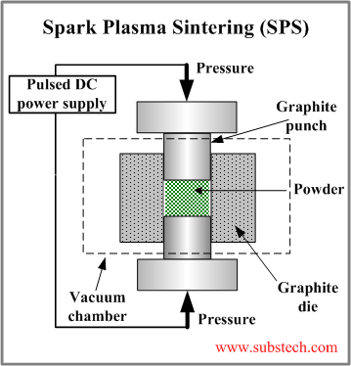
Technique

Slide 16
Ti₃SiC₂
Drawbacks :
Low hardness ( 4GPa )
Moderate flexural strength (200-600 MPa)
Weak wear resistance
Poor oxidation resistance above 1100.c

Slide 17
A Material of Many Talents
Ti3SiC2 is roughly half the density of the alloys used in today’s jet engines and maintains its strength to temperatures that would render the best nickel-based superalloys on the market today unusable.
Ti3SiC2 is Brittle at room temperature is a major problem , but that could be solved by fabricating microstructures with oriented grains. The fact that Ti3SiC2 is damage-tolerant at room temperature is also a plus.

Slide 18
APPLICATION AREAS
1.Jet engine turbine blades
Ti3SiC2 has roughly half the density of the alloys used in today’s jet engines
maintains its strength to temperatures that exceeds the capacity of even the best nickel-based superalloys
2.Electronic contacts and connectors
3.Shaping tools for polymers
4.Corrosion protection or decoration
5.biotechnology

Slide 19
REFERENCES
Links to Internet resources for
“The MAX Phases: Unique New Carbide
and Nitride Materials” are available on the
American Scientist Web site:
http://www.americanscientist.org/articles/01articles/barsoum.html

Slide 20
THANK YOU

Slide 21
Material science Assignment
submitted by
S.Sivaranjini
S.Yogesh
Richard george

